Slide 1



PCOS Prediction & Personalized Diet
Empowering Women's Health and Personalized Care

Slide 2
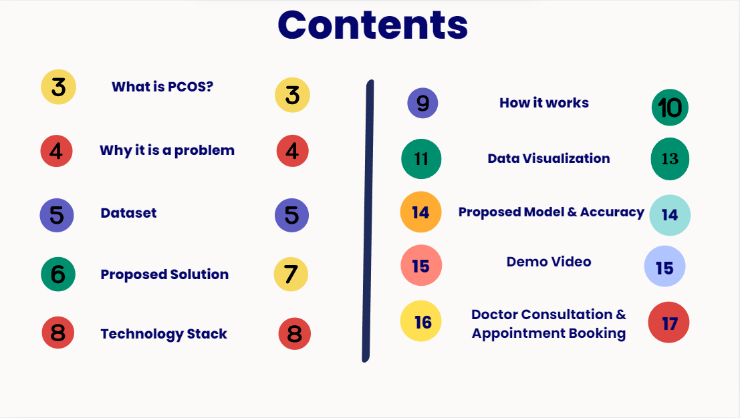

Slide 3


What is PCOS?
Polycystic ovary syndrome (PCOS) is a hormonal condition that affects women of reproductive age. It can cause irregular periods, excess hair, acne, and weight gain. PCOS is a leading cause of infertility.
Symptoms
Irregular periods
Excess body and facial hair
Acne or oily skin
Weight gain, especially around the belly
Thinning hair or male-pattern baldness
Skin tags on the neck or armpits
Dark or thick skin patches on the back of the neck, in the armpits, and under the breasts

Slide 4

Why its a problem?
Significant Undiagnosed Population: PCOS is a widespread hormonal disorder, but a large majority,roughly 70%, of affected women remain undiagnosed. This represents a serious gap in healthcare.
Complex and Variable Symptoms: The wide range and varying intensity of PCOS symptoms make it difficult to identify. Irregular periods, acne, and weight fluctuations can be attributed to other causes, delaying proper diagnosis.
Lack of Accessible Lifestyle Guidance: While diet and lifestyle changes are crucial for PCOS management, readily available, doctor-recommended resources are scarce. This leaves many women struggling to implement effective strategies.

Slide 5
DATASET
📌
🔗
Source:- Kaggle PCOS Dataset.
🩺
This dataset consists of 541 records and 45 features, encompassing physical and clinical parameters essential for diagnosing PCOS and infertility-related issues. It includes patient demographics, hormone levels, menstrual health patterns, lifestyle factors, and medical history, providing valuable insights for early detection, risk assessment, and AI-driven predictive healthcare models.
🩺
The data is collected from 10 different hospitals across Kerala, India, ensuring a diverse and comprehensive representation of PCOS and infertility-related health parameters.

Slide 6


Proposed Solution
AI-Powered PCOS Detection
Using modern-day Machine Learning approaches (Random Forest, CatBoost, XgBoost ,GMM, Hierarchical Clustering) to accomplish accurate predictions regarding the risk of suffering from PCOS.
Risk Assessment & Probability Score
Risk classification of patient candidates into Low, Medium, or High is solely based on the probability score.
Personalized Nutrition & Lifestyle Guidance
The doctor-recommended diet plan and supplement suggestions will promote reproductive health.
If the risk is low, the preventive nutrition plan will be given to help prevent further complication.

Slide 7
Proposed Solution
Smart Doctor Consultation & Appointment Booking
Connects users to specialist gynecologists based on location and availability.
Medium- or High-risk PCOS applicants will be referred to trusted doctors through the system for consultation.
Instant Report Generation & Download
Generates a full-fledged PCOS health report containing risk assessments and recommendations.
Users may also download medical reports and appointment tickets for reference purposes in the future.

Slide 8



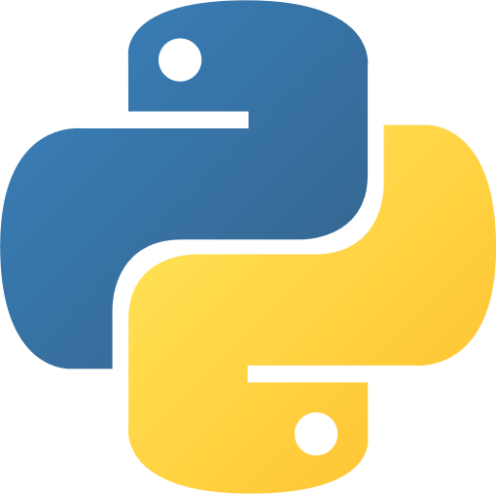

Technology Stack
Deployment & Optimization
Integration & Services
Deploy the application to a cloud platform or hosting service.
Frontend & User Interface
Backend & Logic
Connect with
external services
or build internal
systems for doctor
bookings and other necessary features.
Foundation & Data:
Develop the user
interface, including
data input forms,
result displays, and
doctor booking
interfaces.
Backend Framework
using flask &
Machine Learning
Integration
(Python/scikit-learn/TensorFlow)
Design the schema to handle user data, medical records, and dietary information.

Slide 9
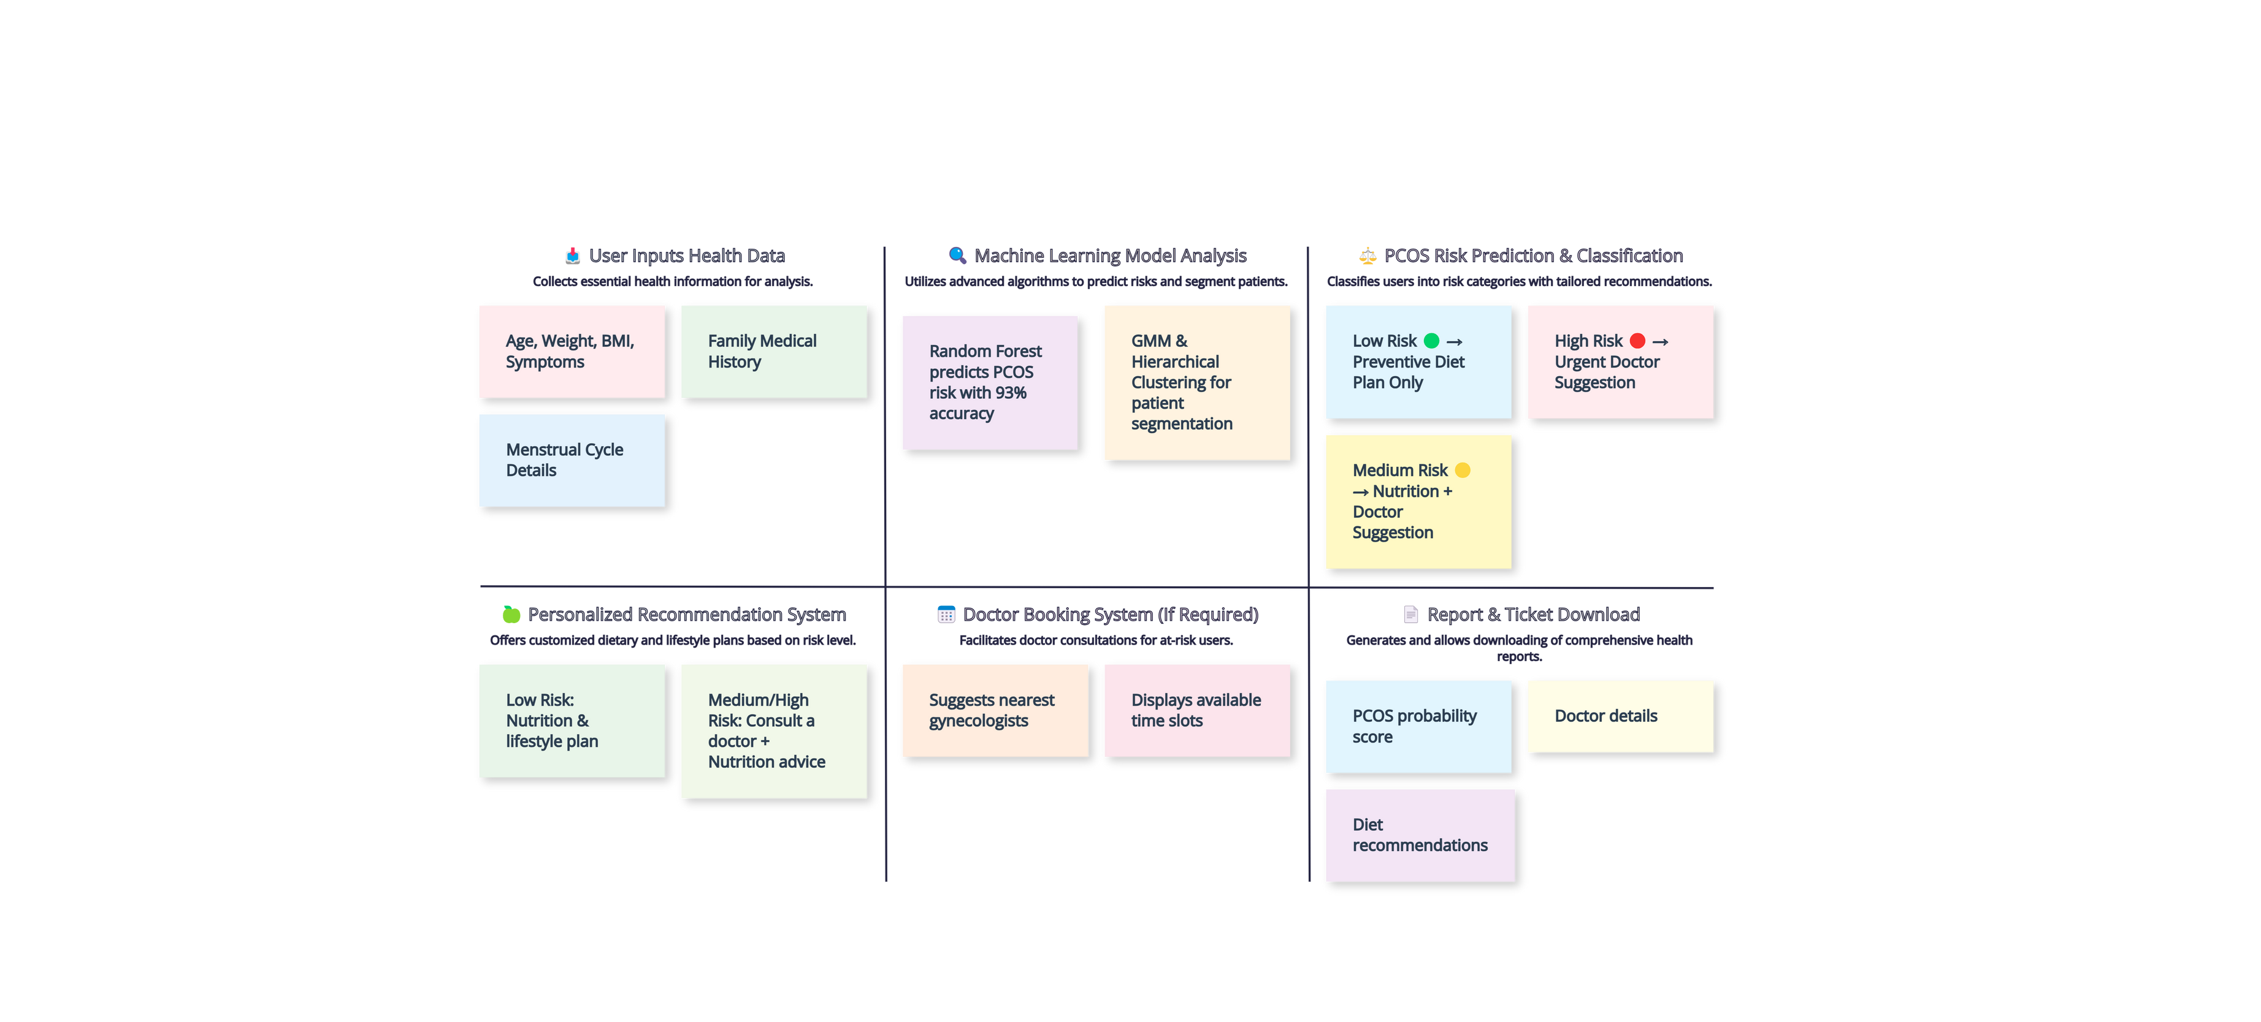
How It Works
1
2
3
4
5
6

Slide 10
How It Works
This web application will provide a comprehensive PCOS risk assessment and personalized management platform for girls. Users will input their health data, which will be processed by integrated machine learning models to determine their PCOS probability score and risk category (low, medium, or high). Based on the risk level, the application will offer tailored solutions: low-risk users receive customized dietary and lifestyle plans, medium-risk users receive combined dietary and doctor consultation recommendations, and high-risk users are directed to urgent medical attention and a doctor booking system. The platform will display the PCOS probability score, personalized diet recommendations, and doctor details (if applicable), ensuring users have access to both preventative lifestyle guidance and timely medical intervention. It will prioritize user experience, data security, and provide accurate, evidence-based information, making it a valuable tool for proactive PCOS management.

Slide 11
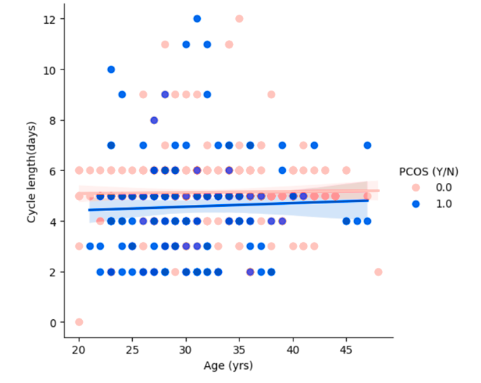
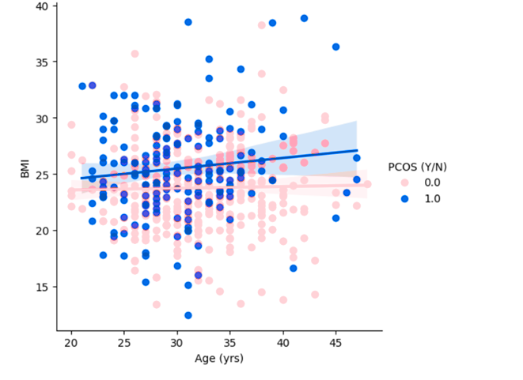
Data Visualization
Length of menstrual phase in PCOS vs normal
Pattern of weight gain (BMI) over years in PCOS and Normal

Slide 12
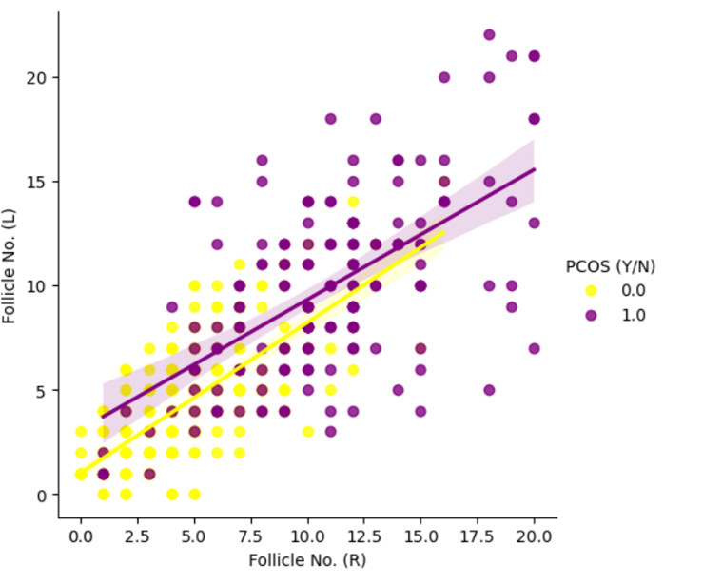
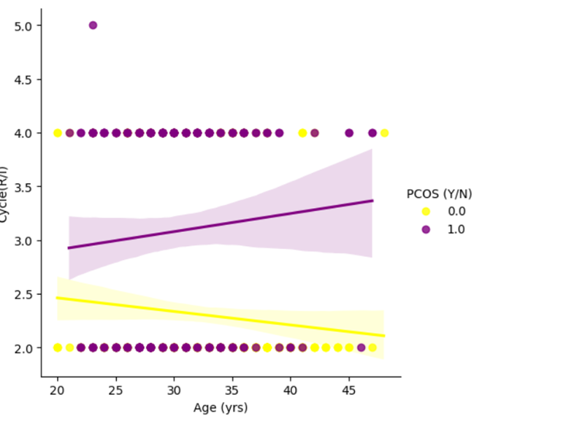
Data Visualization
Distribution of follicles in both ovaries
Cycle IR wrt age

Slide 13
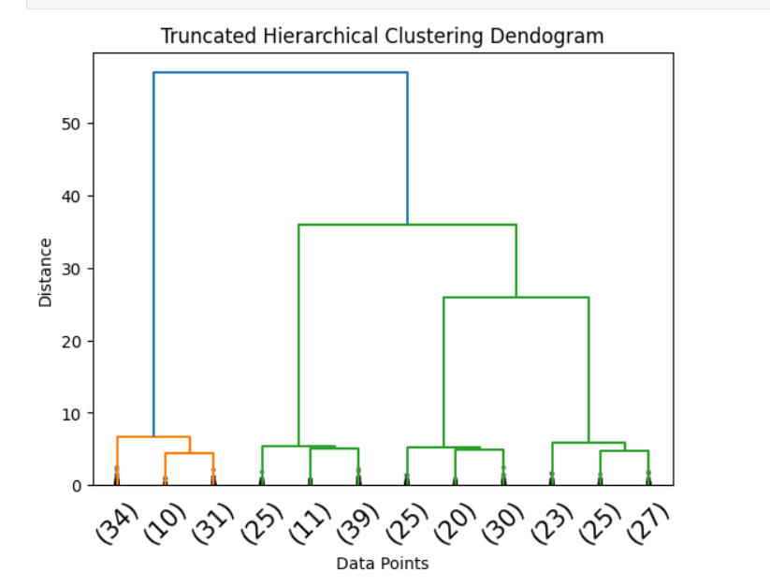
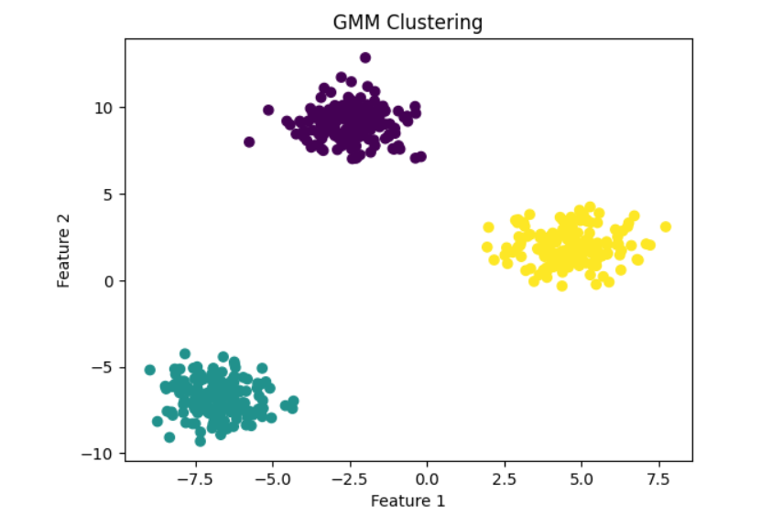
Data Visualization

Slide 14
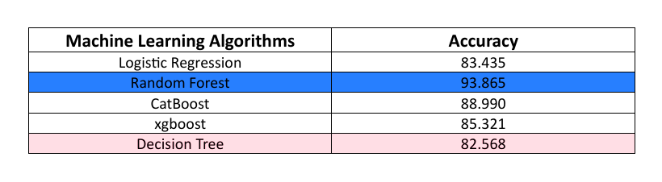
Proposed Model & Accuracy
Given that Random Forest exhibits the highest accuracy and Logistic Regression the lowest within the evaluated machine learning models, the application should prioritize the Random Forest model for PCOS risk prediction.

Slide 15
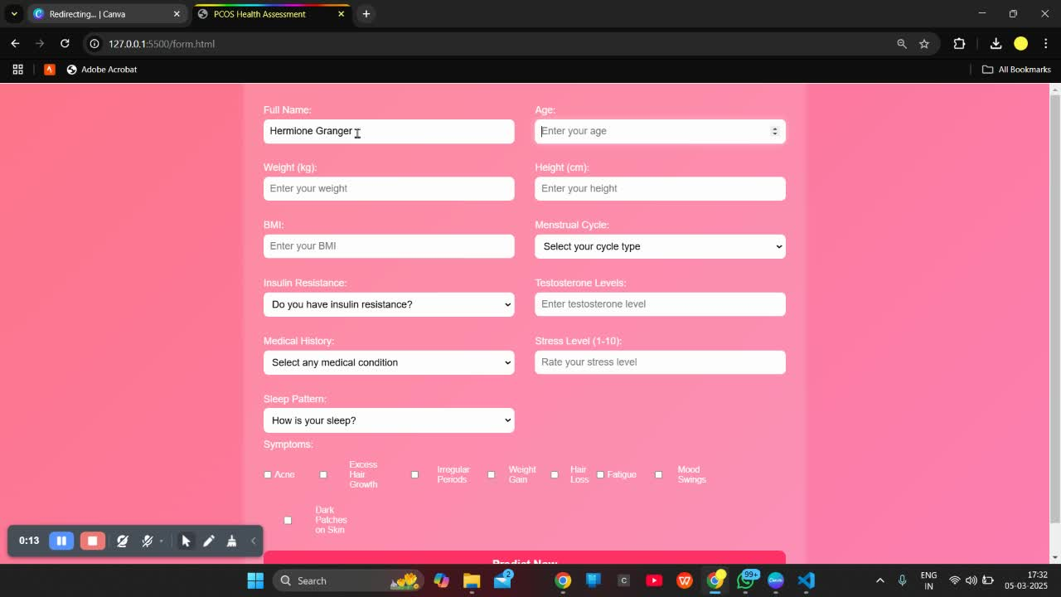
Demo Video

Slide 16

Doctor Consultation & Appointment Booking
In the future, this platform will provide seamless connectivity with qualified PCOS specialists through an easy-to-use online appointment booking system, ensuring users receive timely, personalized care. This will facilitate prompt medical intervention when necessary, empowering girls to proactively manage their PCOS and improve their overall health.

Slide 17


Doctor Consultation & Appointment Booking
Moving forward, our application will generate comprehensive, downloadable reports designed for personal health tracking and seamless sharing with healthcare providers. These reports will empower users with actionable insights into their PCOS risk and management, allowing them to actively participate in their healthcare journey and facilitate informed discussions with their medical professionals.

Slide 18

Thank you!

